Slide 1


INF 112
OBLIG 3
GROUP 6
TEAM PRESENTATION

Slide 2







TEAM MEMBERS
AND ROLES
Who we are and how we worked
Sverre – Test manager
Loc - Graphics
Benjamin – Coder
Eirik – Code
Stian – Meeting lead, AI and Version control
Vegard – documentation manager
Robin E – Test manager
Robin G – GUI
1
of
6

Slide 3
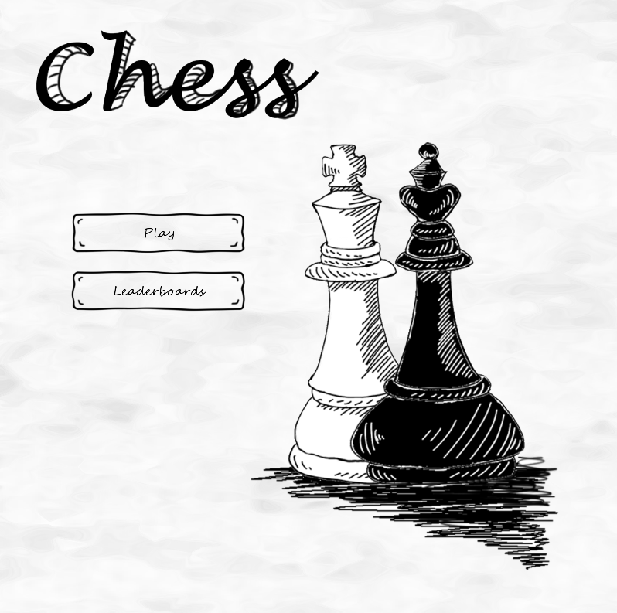
THE
GAME
2
of
6

Slide 4
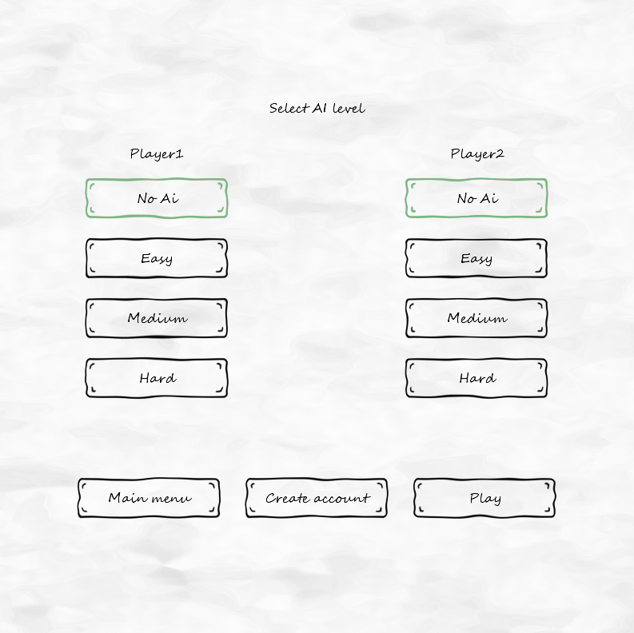
3
of
6

Slide 5
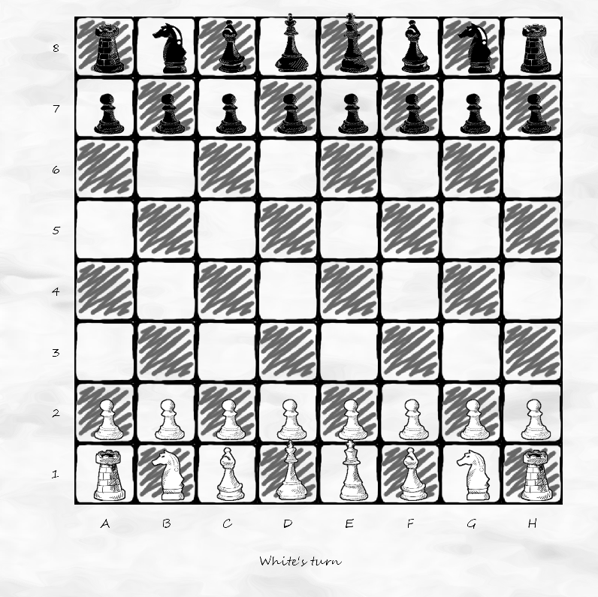
5
of
8

Slide 6
6
of
9

Slide 7
PROCESS
AND TOOLS
HOW WE WORKED
Gitlab
SCRUM
LIBGDX
Maven
Junit
JavaDoc
7
of
9

Slide 8

THE GOOD, THE BAD
THE UGLY
Our good and bad moments
The Good
Quick to get organized, assigning roles
High team spirit
Good overall team competence
Frequent communication
8
of
9

Slide 9

THE GOOD, THE BAD
THE UGLY
Our good and bad moments
The Good
The Bad
Quick to get organized, assigning roles
High team spirit
Good overall team competence
Frequent communication
Hard to keep focused
Overkill time use on UI and AI
Maven issues
7
of
8

Slide 10
Retrospective
SUMMARY
Results of this project
Meeting/communication organization
Role distribution
Tools for later iterations chosen
General project plan
Deliverables
In retrospect...
In conclusion:
Minutes “Meeting review” section
Recurring: focus
Meeting discussion transition: wide → narrow
Deliverables: abstract → concrete
Group has largely been experimenting
Process has changed a lot in a short space of time
This is a starting point
8
of
8

Slide 11
THANK YOU

